Slide 1
COMP 472 - Assignment 3
Andrew Korolus (40055081)

Slide 2
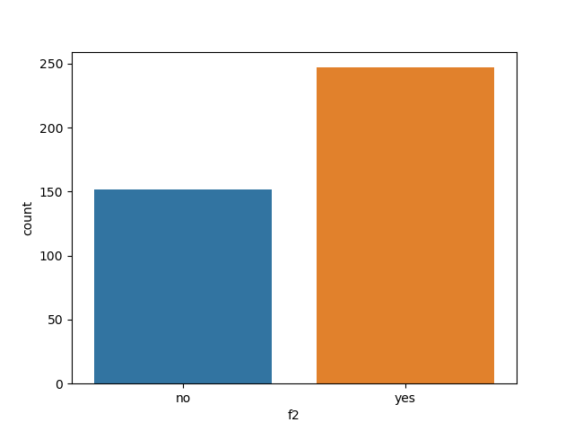
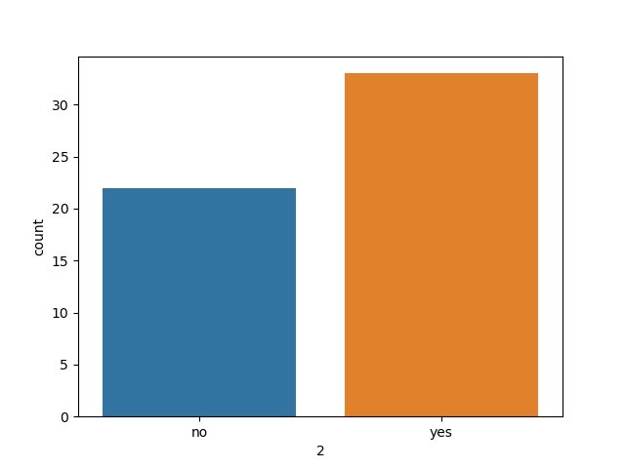
Data Set
Training Set (400 total)
Test Set (55 total)

Slide 3
Vocabulary

Slide 4
Results
 | Accuracy | Precision |  | Recall |  | F1-Measure
Model Class: |  | Yes | No | Yes | No | Yes | No
NV-BOW-OV | 0.6000 | 0.6038 | 0.5000 | 0.9697 | 0.0455 | 0.7442 | 0.0833
NV-BOW-FV | 0.6545 | 0.6400 | 0.8000 | 0.9697 | 0.1818 | 0.7711 | 0.2963
LSTM | 0.6296 | 0.6327 | 0.6000 | 0.9394 | 0.1429 | 0.7561 | 0.2308

